Slide 1

POTHOLE CHALLENGE
TEAM NAME: WHIZ-KIDS
MINISTRY : Government Of Goa
CATEGORY : Software
TECHNOLOGY BUCKET: Mobile App Development
PROBLEM STATEMENT: The state of Goa is facing one of the biggest problem of potholes. Biggest problem in solving the problem of pothole is lack of coordination between concerned departments. The aim is to build mobile based dynamic reporting system which will facilitiate into flow of information among all concerned stakeholders. The aim is also to provide better Governance by more involvement of public.
TEAM MEMBERS: Ameesha Jain , Aishwarya Verma ,Ayushi Dixit ,Anukriti Sharma ,
Abhitansh Gupta , Bhagya Singh Purba

Slide 2
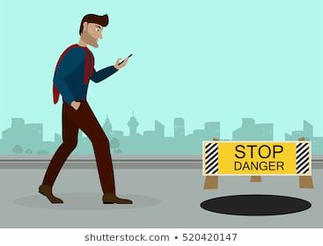










PROTOTYPE
1
2
3
Report
3. CLICK THE PHOTO OF
THE POTHOLE BY USING
OUR APP
1. POTHOLE SPOTTED
2. LOGIN AND REPORT INTO
OUR MOBILE APP
6
4
5
5. STORING INFO. GIVEN
BY USER
4. GIVING THE LOCATION
OF POTHOLE BY USING
GPS.
6. PROVIDING STORED INFO TO
MUNICIPAL CORPORATION

Slide 3
USE CASE DIAGRAM
REGISTER
LOGIN
LOGIN ERROR
VERIFY PASSWORD
MAKE A REPORT
USER
LOCATION INFO.
MUNICIPAL
UPLOAD PHOTO
SUBMIT

Slide 4
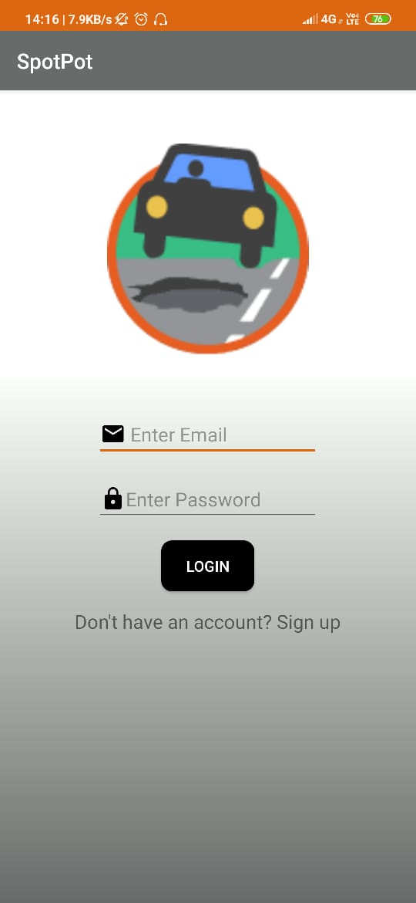
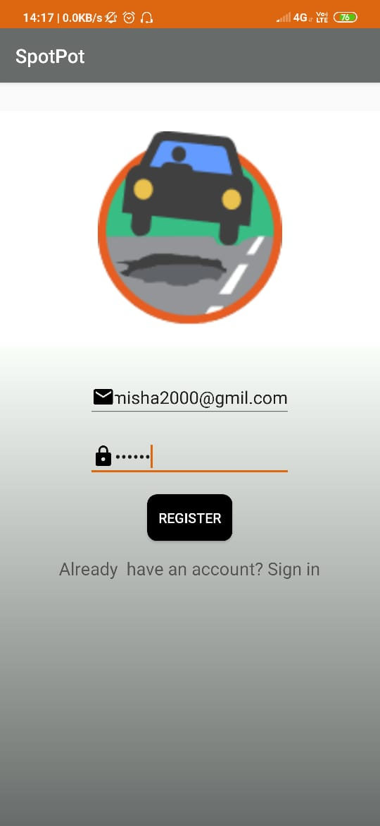
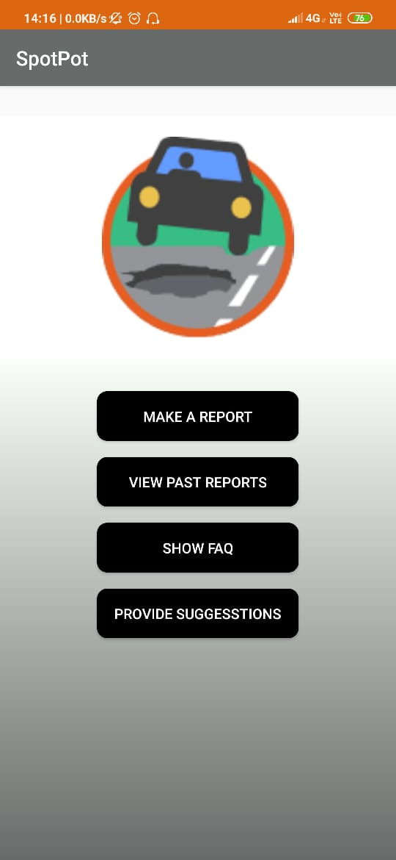
WORKING OF OUR APP
LOGIN INTO OUR APP IF REGISTERED
2. IF NOT THEN REGISTER
YOURSELF HERE
3. AFTER LOGIN CLICK ON
“MAKE A REPORT”

Slide 5
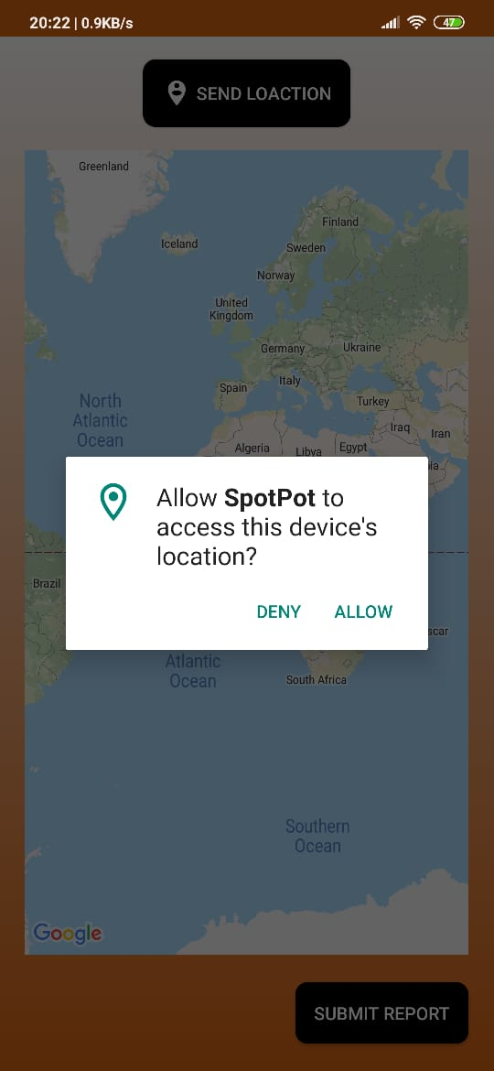
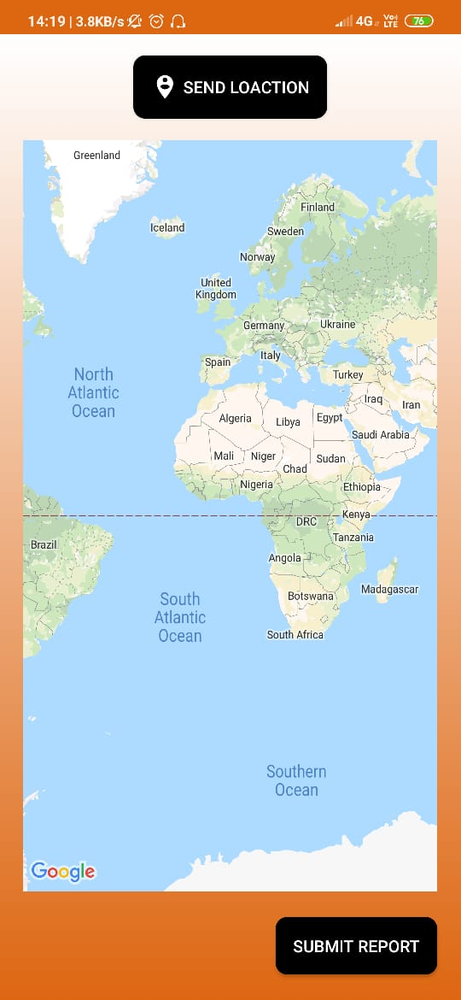
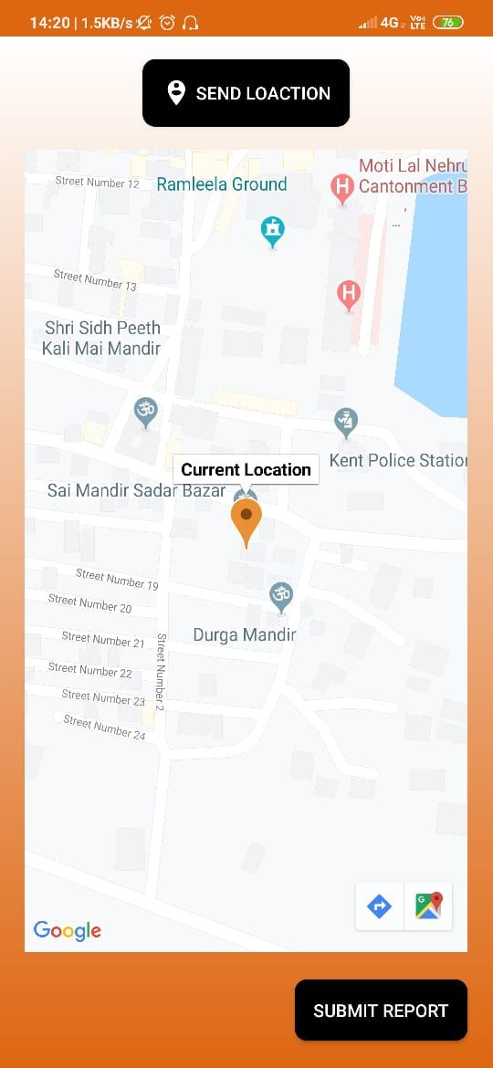
4. AFTER CLICKING ON“MAKE
A REPORT” LOCATION
ACTIVITY OPENS
5. WHEN USER CLICK ON
“SEND LOCATION” IT
SEARCH FOR CURRENT
LOCATION
6. WHEN CURRENT LOCATION
IS FOUND USER WILL CLICK
ON “SUBMIT”

Slide 6
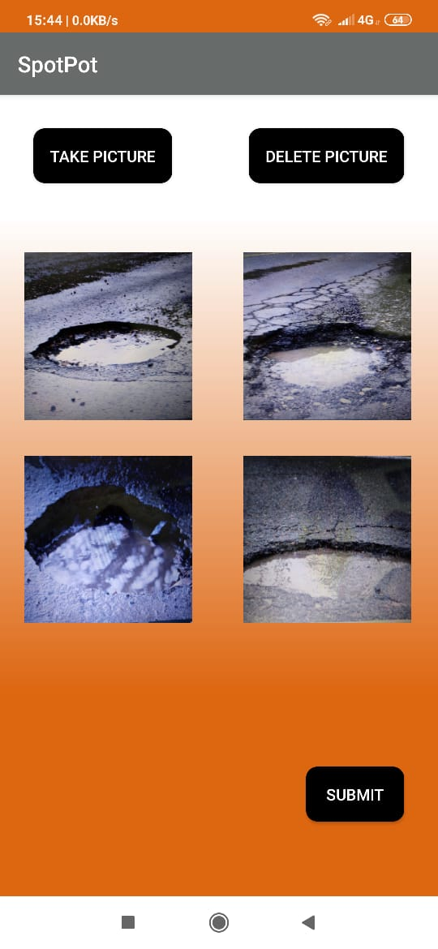
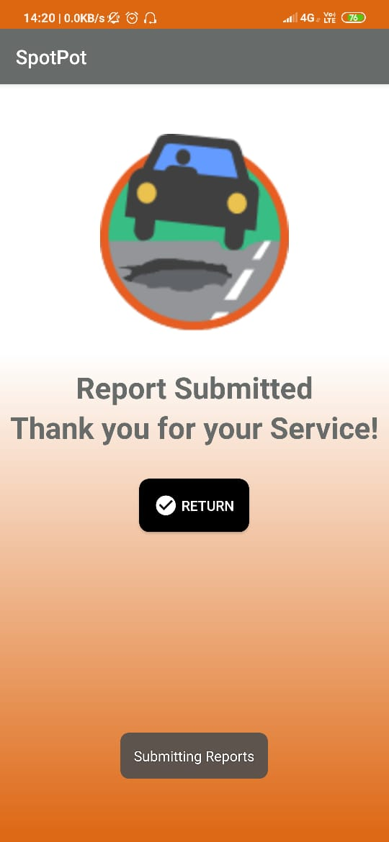
7. AFTER SUBMITTING LOCATION
CAMERA ACTIVITY OPENS AND
USER TAKE PHOTO AND CLICK
“SUBMIT”
8. WHEN REPORT IS SUBMITTED
A ACTIVITY IS SHOWN OF
SUCCESSFUL SUBMISSION
9. IF A PERSON CLICKS
“RETURN” THEY WILL
COME TO MAIN MENU

Slide 7
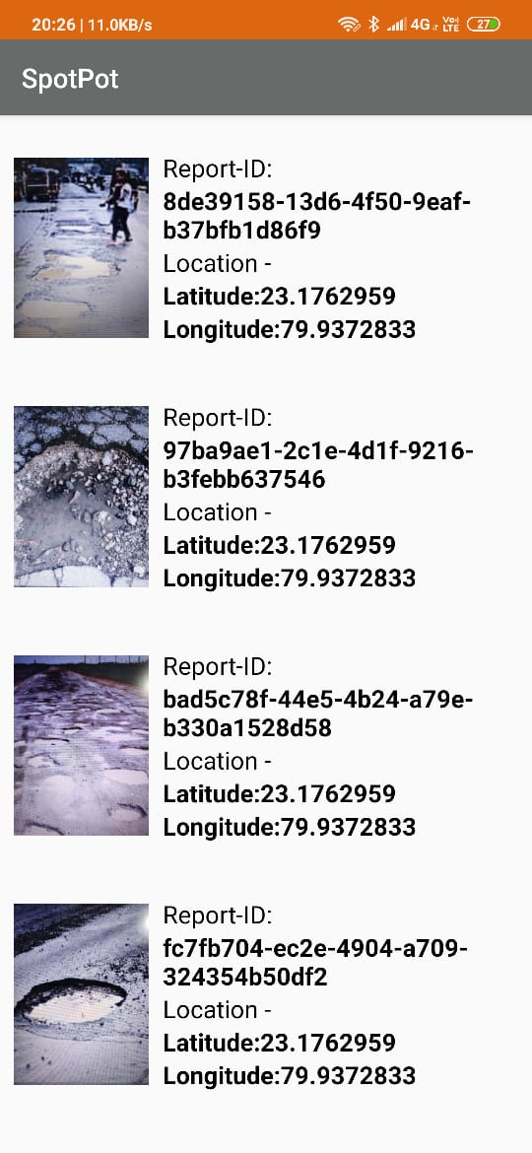
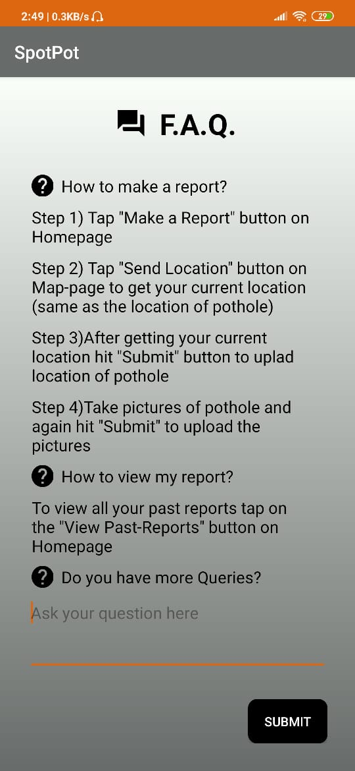
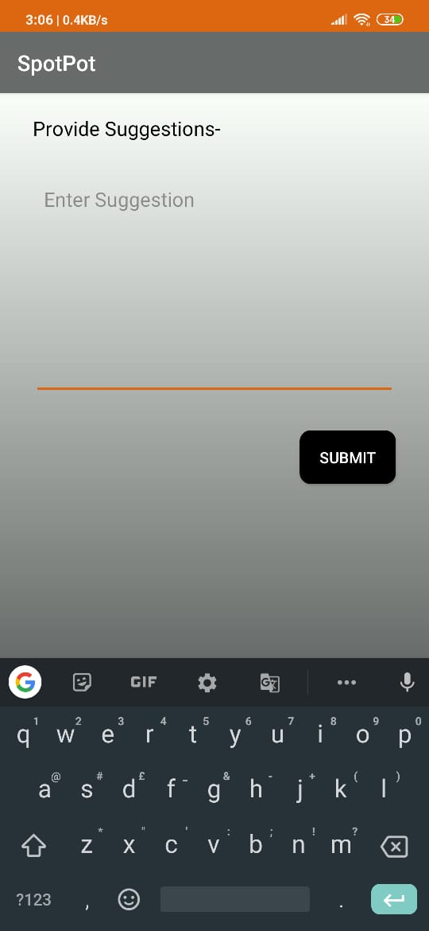
10. WHEN USER CLICK “VIEW
PAST REPORTS” , ACTIVITY
SHOWN BELOW OPENS
11. WHEN A USER CLICK ON
“SHOW FAQ” AN ACTIVITY
DISPLAYING FAQ IS OPENED
12. WHEN USER CLICK “PROVIDE
SUGGESTIONS” AN ACTIVITY
OPENS WHERE USER SUBMIT
SUGGESTIONS.

Slide 8
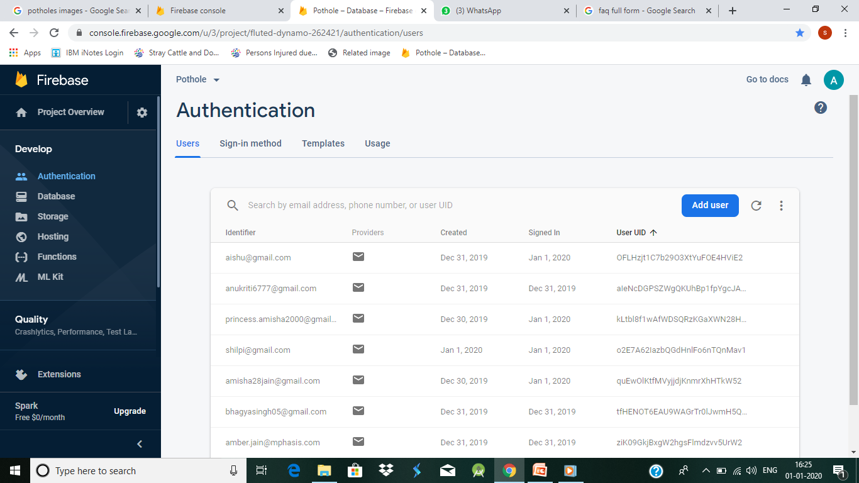
DATABASE CONNECTIVITY OF OUR APP
WHEN A USER LOGIN INTO OUR APP THEN THERE LOGIN INFO. IS STORED OUR DATABASE
AND EACH USER IS ASSIGNED A UNIQUE USER UID.

Slide 9
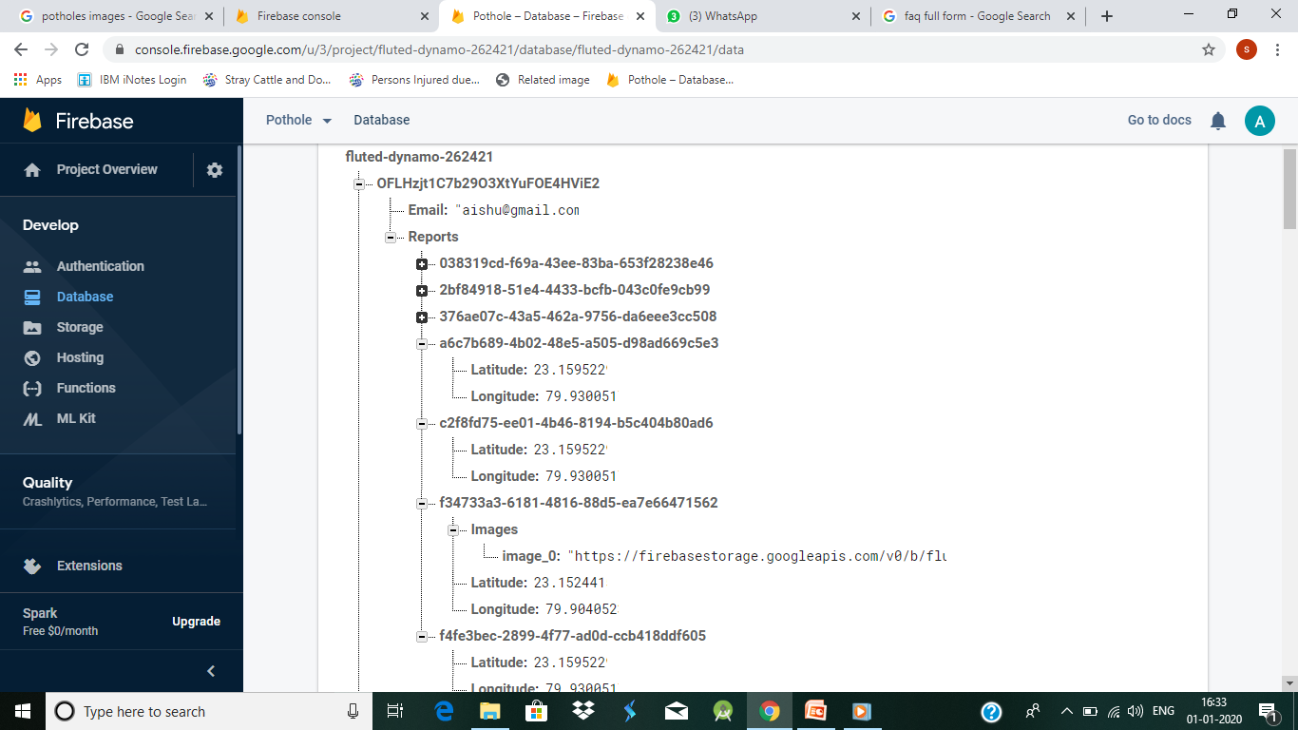
2. WHEN A USER SUBMIT THE LOCATION AND IMAGE OF POTHOLE THE DETAILS ARE STORED
IN THE DATABASE AND UNIQUE REPORT ID IS GENERATED

Slide 10
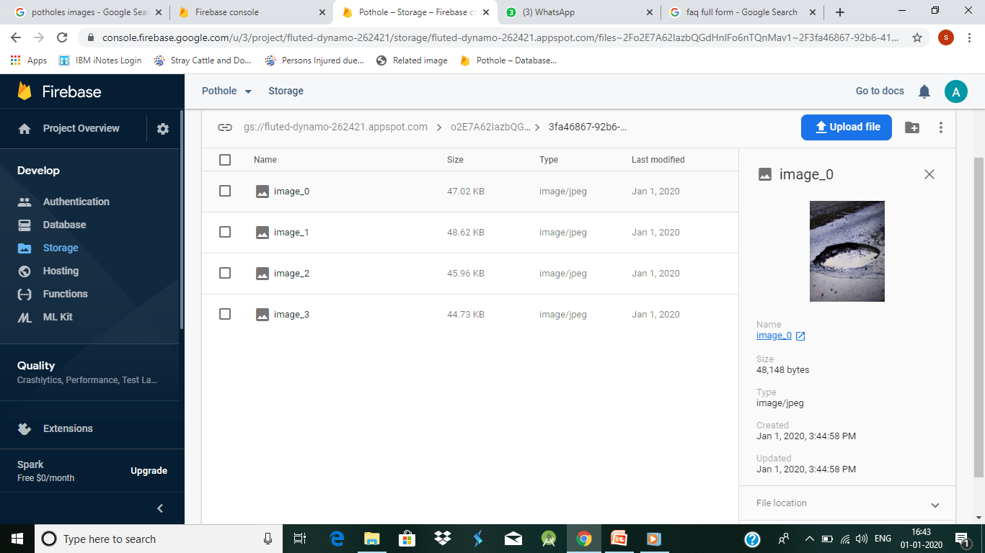
3. THE IMAGES SUBMITTED BY EACH USER IS STORED IN STORAGE SECTION OF DATABASE AND
CAN BE ACCESSED WITH THE HELP OF UNIQUE USER UID AND REPORT ID

Slide 11
TECHNOLOGY STACK
FRONT END:
ANDROID STUDIO
BACK END:
FIREBASE DATBASE
LANGUAGE:
JAVA

Slide 12
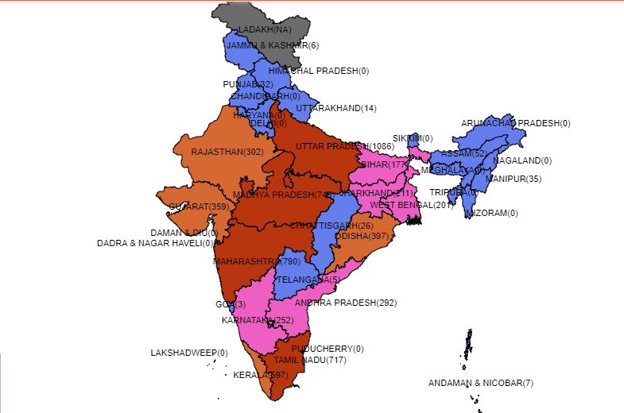
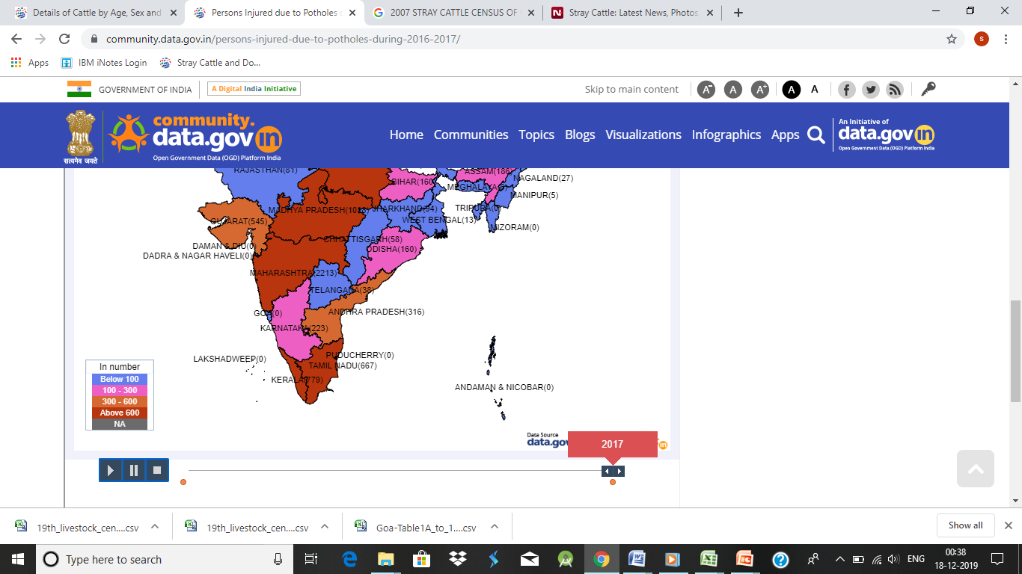
NO. OF PEOPLE INJURED DUE TO POTHOLE IN 2015-17

Slide 13
DEPENDENCIES
THROUGH THIS APP TILL NOW WE CANNOT TELL THE EXCAT SIZE OF THE POTHOLE ABOUT WHICH THE USER REPORTS .
AFTER THE USER REPORTS ABOUT THE POTHOLE THROUGH OUR APP WE CANNOT SHOW OUR USERS THAT WHAT ACTIONS ARE TAKEN BY THE MUNICIPAL CORPORATION REGARDING THE REPORT.
THESE DEPENDENCIES CAN BE SOLVED IN FUTURE BY
ENHANCING OUR APP.

Slide 14
CONCLUSION
OUR APP CAN BE USED TO PERFORM FUNCTIONS LISTED BELOW :-
REPORTING : OUR APP CAN SUCCESSFULLY REPORT THE POTHOLES TO THE MUNICIPAL CORPORATION.
DATA GATHERING: THIS APP WILL HELP THE GOVERNMENT
TO GATHER THE INFORMATION REGARDING THE POTHOLES
AND FREQUNCY OF THERE OCCURENCE.
3. DATA ANALYSIS : THROUGH THE DATA COLLECTED BY
OUR APP WE CAN ANALYZE :
THE CONDITION OF ROAD
NUMBER OF ACCIDENTS CAUSED BY THE POTHOLE

